Slide 1
Machine-Level Programming I: architecture, assembly and object code

Slide 2
Machine Programming I: Basics
History of Intel processors and architectures
C, assembly, machine code
Assembly Basics: Registers, operands, move
Arithmetic & logical operations

Slide 3
Definitions
Architecture: (also ISA: instruction set architecture) The parts of a processor design that one needs to understand or write assembly/machine code.
Examples: instruction set specification, registers.
Microarchitecture: Implementation of the architecture.
Examples: cache sizes and core frequency.
Code Forms:
Machine Code: The byte-level programs that a processor executes
Assembly Code: A text representation of machine code
Example ISAs:
Intel: x86, IA32, Itanium, x86-64
ARM: Used in almost all mobile phones

Slide 4
Assembly/Machine Code View
CPU
Memory
Registers
Addresses
Data
Code
Data
Stack
PC
Condition
Codes
Instructions
Programmer-Visible State
PC: Program counter
Address of next instruction
Called “RIP” (x86-64)
Register file
Heavily used program data
Condition codes
Store status information about most recent arithmetic or logical operation
Used for conditional branching
Memory
Byte addressable array
Code and user data
Stack to support procedures

Slide 5
Turning C into Object Code
Code in files p1.c p2.c
Compile with command: gcc –Og p1.c p2.c -o p
Use basic optimizations (-Og) [New to recent versions of GCC]
Put resulting binary in file p
text
C program (p1.c p2.c)
Compiler (gcc –Og -S)
text
Asm program (p1.s p2.s)
Assembler (gcc or as)
binary
Object program (p1.o p2.o)
Static libraries (.a)
Linker (gcc or ld)
binary
Executable program (p)

Slide 6
Compiling Into Assembly
C Code (sum.c)
Generated x86-64 Assembly
long plus(long x, long y);
void sumstore(long x, long y,
long *dest)
{
long t = plus(x, y);
*dest = t;
}
sumstore:
pushq %rbx
movq %rdx, %rbx
call plus
movq %rax, (%rbx)
popq %rbx
ret
Obtain (on VM) with command
gcc –Og –S sum.c
Produces file sum.s
Warning: May get very different results on other machines, even other Linux machines, due to different versions of gcc and different compiler settings.

Slide 7
Aside: Assembly ‘Syntax’
Different ways to write down assembly.
AT&T / GAS Syntax
Used by gcc.
Used in this course.
Intel / MASM Syntax
Might get if you google (try your Textbook instead)
Doesn’t use size suffixes (ie, ‘q’)
mnemonic source, destination
mnemonic destination, source

Slide 8
One more time, just to be clear
In this course:
mnemonic source, destination
So:
addq %rax, %rbx
Is equivalent to:
%rbx = %rbx+%rax

Slide 9
Assembly Characteristics: Data Types
“Integer” data of 1, 2, 4, or 8 bytes
Data values
Addresses (untyped pointers)
Floating point data of 4 or 8 bytes
Code: Byte sequences encoding series of instructions
No aggregate types such as arrays or structures
Just contiguously allocated bytes in memory

Slide 10
Assembly Characteristics: Operations
Perform arithmetic function on register or memory data
Transfer data between memory and register
Load data from memory into register
Store register data into memory
Transfer control
Unconditional jumps to/from procedures
Conditional branches

Slide 11
Object Code
Code for sumstore
Assembler
Translates .s into .o
Binary encoding of each instruction
Nearly-complete image of executable code
Missing linkages between code in different files
Linker
Resolves references between files
Combines with static run-time libraries
E.g., code for malloc, printf
Some libraries are dynamically linked
Linking occurs when program begins execution
0x0400595:
0x53
0x48
0x89
0xd3
0xe8
0xf2
0xff
0xff
0xff
0x48
0x89
0x03
0x5b
0xc3
Total of 14 bytes
Each instruction 1, 3, or 5 bytes
Starts at address 0x0400595

Slide 12
Machine Instruction Example
C Code
Store value t where designated by dest
Assembly
Move 8-byte value to memory
Quad words in x86-64 parlance
Operands:
t: Register %rax
dest: Register %rbx
*dest: Memory M[%rbx]
Object Code
3-byte instruction
Stored at address 0x40059e
*dest = t;
movq %rax, (%rbx)
0x40059e: 48 89 03

Slide 13
Disassembling Object Code
Disassembled
0000000000400595 <sumstore>:
400595: 53 push %rbx
400596: 48 89 d3 mov %rdx,%rbx
400599: e8 f2 ff ff ff callq 400590 <plus>
40059e: 48 89 03 mov %rax,(%rbx)
4005a1: 5b pop %rbx
4005a2: c3 retq
Disassembler
objdump –d sum
Useful tool for examining object code
Analyzes bit pattern of series of instructions
Produces approximate rendition of assembly code
Can be run on either a.out (complete executable) or .o file

Slide 14
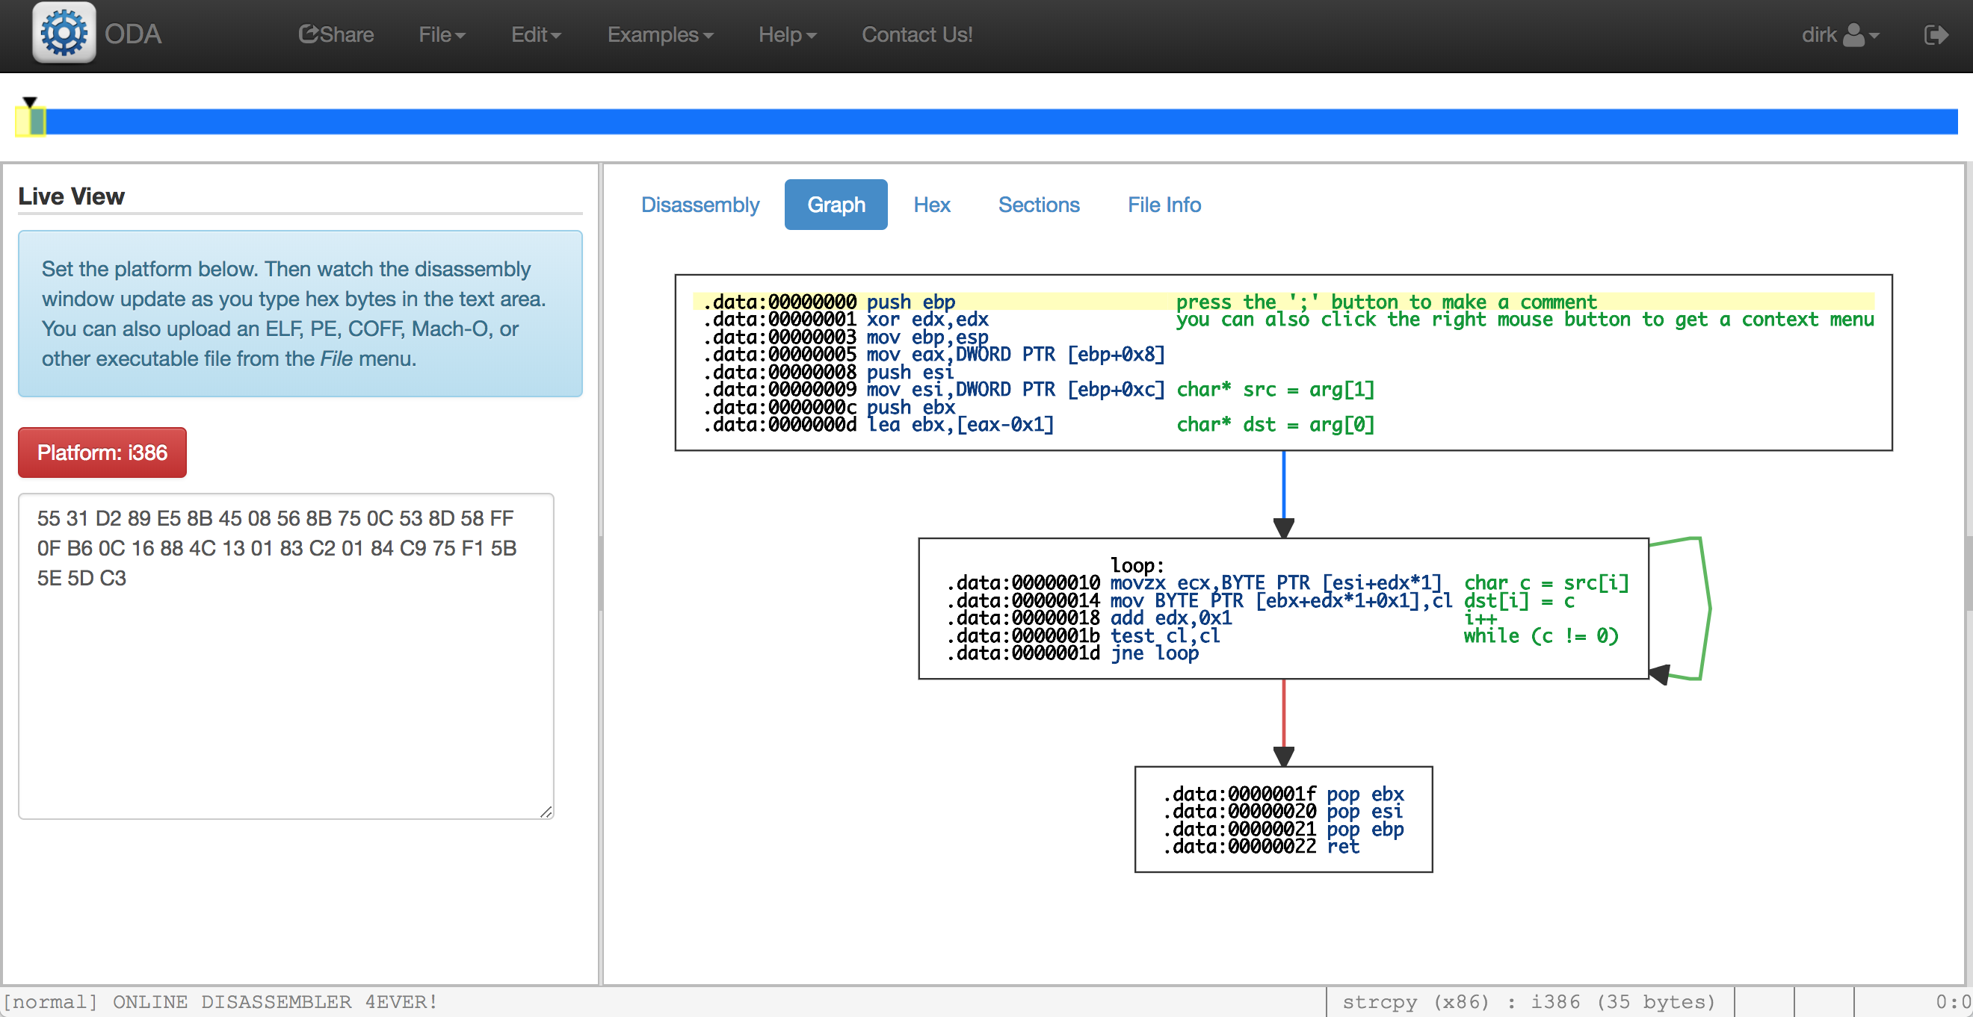
Web-Based https://onlinedisassembler.com

Slide 15
Alternate Disassembly
Disassembled
Object
0x0400595:
0x53
0x48
0x89
0xd3
0xe8
0xf2
0xff
0xff
0xff
0x48
0x89
0x03
0x5b
0xc3
Dump of assembler code for function sumstore:
0x0000000000400595 <+0>: push %rbx
0x0000000000400596 <+1>: mov %rdx,%rbx
0x0000000000400599 <+4>: callq 0x400590 <plus>
0x000000000040059e <+9>: mov %rax,(%rbx)
0x00000000004005a1 <+12>:pop %rbx
0x00000000004005a2 <+13>:retq
Within gdb Debugger
gdb sum
disassemble sumstore
Disassemble procedure
x/14xb sumstore
Examine the 14 bytes starting at sumstore

Slide 16
What Can be Disassembled?
% objdump -d WINWORD.EXE
WINWORD.EXE: file format pei-i386
No symbols in "WINWORD.EXE".
Disassembly of section .text:
30001000 <.text>:
30001000: 55 push %ebp
30001001: 8b ec mov %esp,%ebp
30001003: 6a ff push $0xffffffff
30001005: 68 90 10 00 30 push $0x30001090
3000100a: 68 91 dc 4c 30 push $0x304cdc91
Reverse engineering forbidden by
Microsoft End User License Agreement
Anything that can be interpreted as executable code
Disassembler examines bytes and reconstructs assembly source

